Slide 1
Attachment
An emotional bond between a child and their parent or guardian.

Slide 2
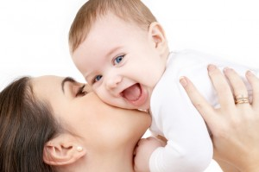
Attachment Theory
Belief that the ability to become attached to another person in early childhood is genetic and that all human beings possess said ability.
It is also believed that the need to become attached is natural.
Isn't always reciprocal.
Children display behaviours such as seeking proximity with their parent when they feel upset of threatened.
Explains parent-child relationship and how it influences a child's development.

Slide 3
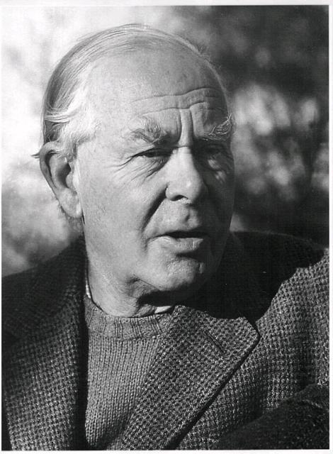
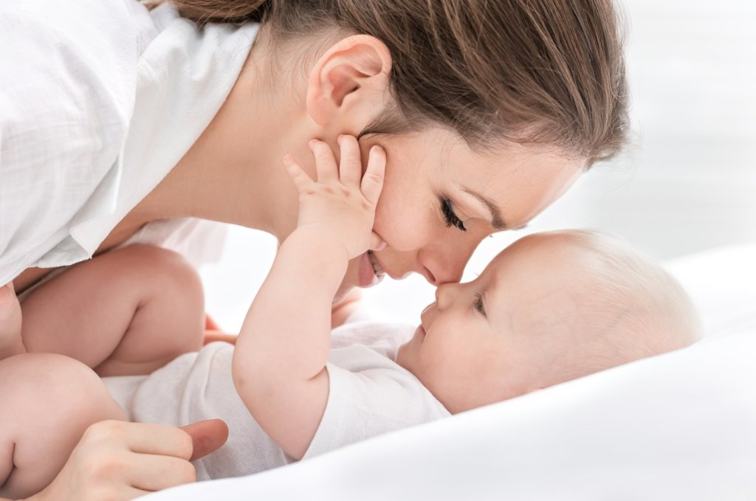
John Bowlby
Psychiatrist in a Child Guidance Clinic in London
Treated emotionally disturbed children.
Explored the importance of the child’s relationship with their mother and how it would affect social, emotional and cognitive development.
Link between early infant separations with the mother and later instability or disturbances.

Slide 4
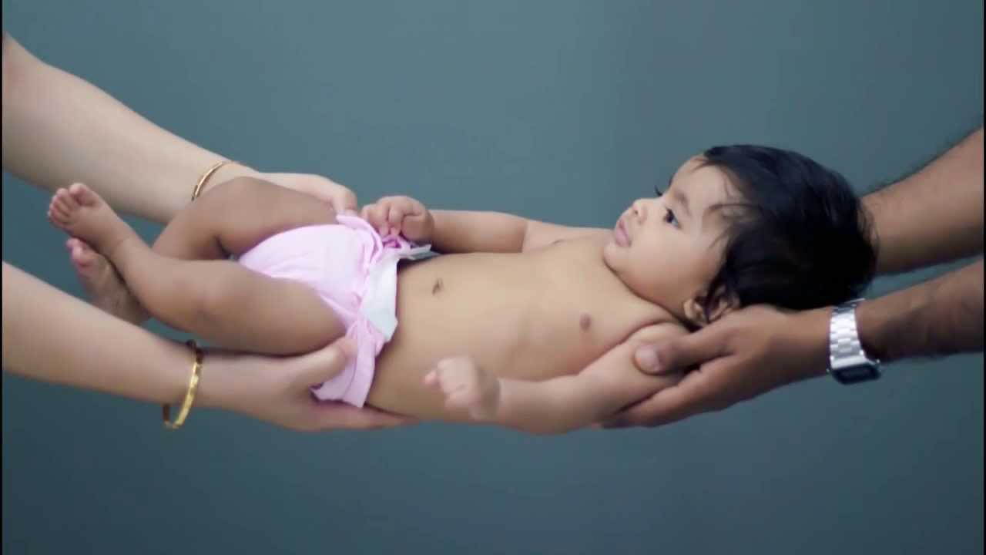
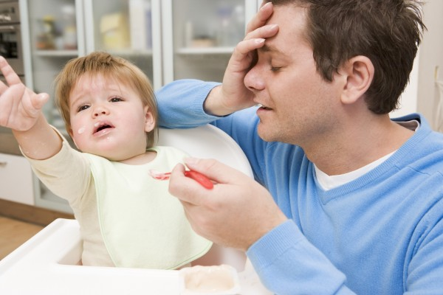
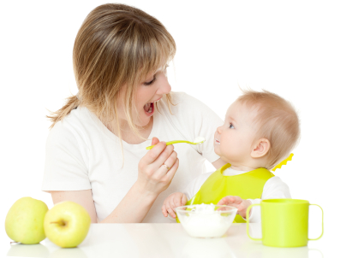
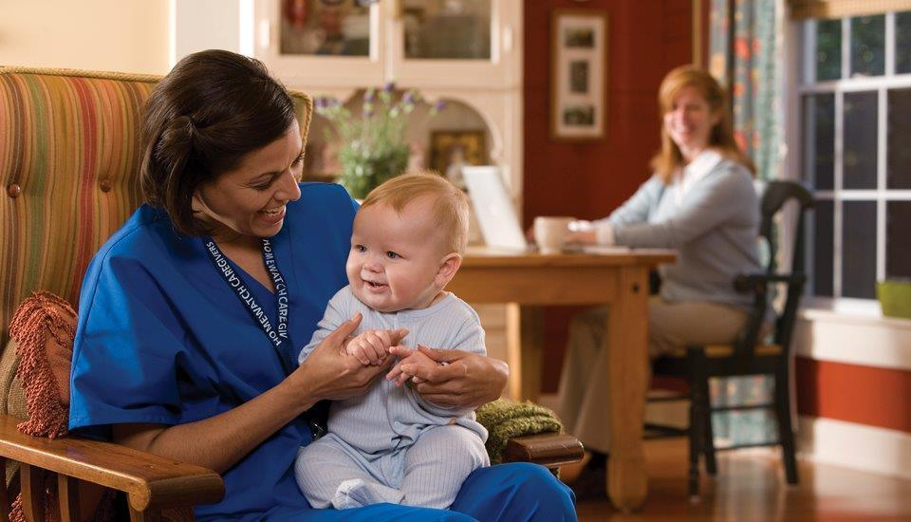
Stages of Attachment
Up to 3 Months- Newborns respond equally to any caregiver.
After 4 months- Infants begin to show preference.
After 7 months- Infants form an emotional attachment to one primary caregiver.
After 9 months- Forms multiple attachments. Begins to show increasing independence.

Slide 5
Types or Patterns of Attachment
Secure
Ambivalent
Avoidant
Disorganized/ Disoriented
Synchrony

Slide 6
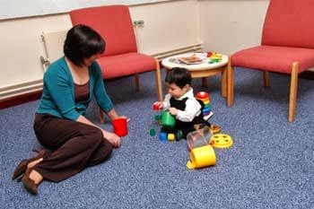
Secure Attachment
separates from the parent willingly
seeks proximity when stressed
needs parent present to start and endure with exploration

Slide 7
Ambivalent Attachment
is greatly upset when separated from the parent
not reassured by the parent's return
does not show signs of wonder or exploration
not easily comforted

Slide 8
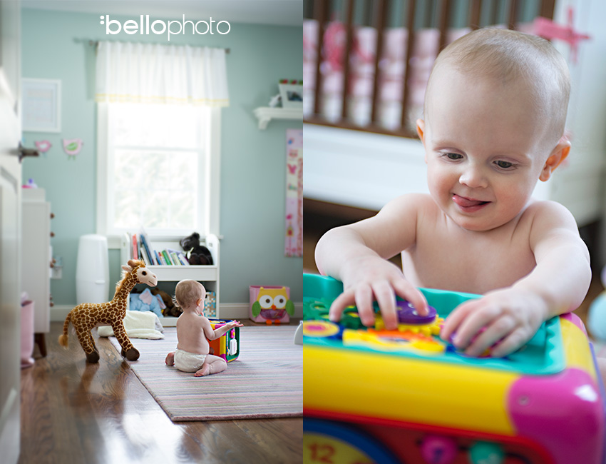
Avoidant Attachment
avoids contact with the parent
shows no preference

Slide 9
Disorganized/Disoriented Attachment
infant seems confused, anxious, worried, hesitant or fearful
shows contradictory behaviour.
might move toward the parent while looking away from him or her.

Slide 10
Synchrony
Reciprocal attachment pattern shared by parent and child.
Child and parents may both show signs of great emotional attachment making it difficult for both to leave one another.

Slide 11
Separation Anxiety
Anxiety that arises when a child is separated or is threatened to be separated from a parent.
Child expresses discomfort by crying or yelling

Slide 12
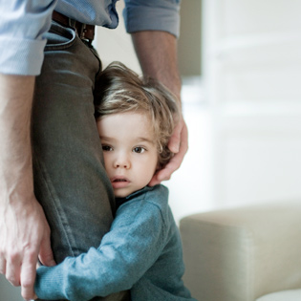
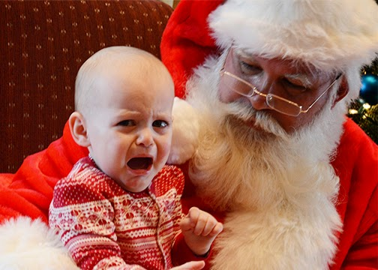
Stranger Anxiety
Anxiety formed when a child is around a stranger
Child will usually seek proximity to a parent
May grab parent tightly

Slide 13
How is Attachment relevant to me personally?
I myself plan to have children one day and it is very good to know that attachment….
is important to a Childs development.
can form at different times or in stages
may or may not be reciprocal
can result in discomfort
is natural
has different types and behavioural associations or characteristics.

Slide 14
How is Attachment related to my chosen profession?
In the early childhood education field it is very important to have a strong knowledge of attachment because parents and children both experience separation anxiety when the child is dropped of at daycare or preschool. We need to know what to say and do to ensure that the child knows their parent is and will always come back for them. We can even help the parents by sharing our knowledge so that they may ensure that the child has an easier time adjusting.

Slide 15
References
15FL PSY-1170-C05 class notes, files etc on canvas (not sure how to reference these documents to if anyone knows how that information would be greatly appreciated)
Lifespan Development Text

